Slide 1
CRAFT BEER CASE STUDY
LIJO JACOB, JAKE RASTBERGER

Slide 2
AGENDA
Introduction
Breweries per State
Missing Values
ABV & IBU
Recommendation
Summary

Slide 3


MEET OUR TEAM
LIJO JACOB
JAKE RASTBERGER

Slide 4
Breweries per state

Slide 5
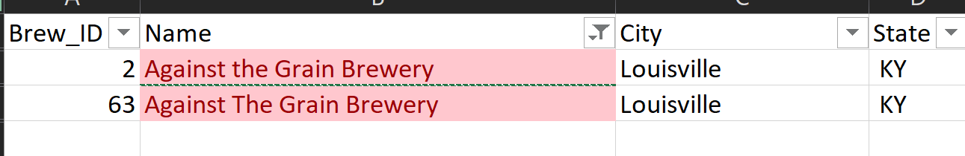
Duplicated Breweries
The dataset we received contained some duplicated breweries. We removed these duplicated breweries if the name, city and State were all duplicates.

Slide 6
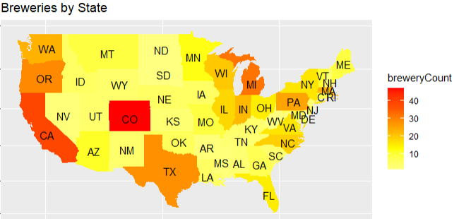
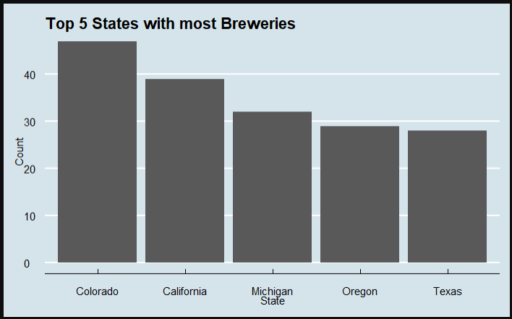
Breweries per state
Most of the breweries seems to be clustered along the west cost, northeast and eastern Midwest US.
It is also worth noting a large amount in both Colorado and Texas.

Slide 7
Missing Data

Slide 8
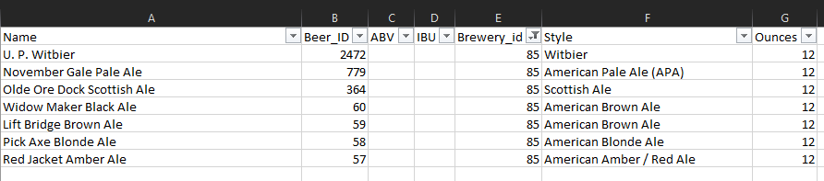
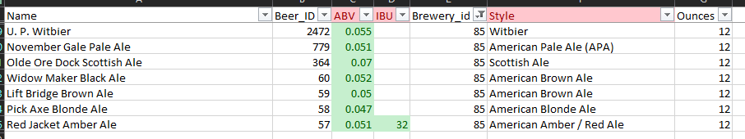
Missing data
Lots of missing data in ABV and IBU columns. We filled in the data as best we could using external resources.
Missing data was highly correlated to certain breweries so imputation and exclusion would not be a valid option.
After filling in most of ABV data we dropped N/A’s and then imputed the mean for remaining IBU if it was missing based on beer style. Total number of dropped beers is 23 or ~ 1% of total

Slide 9
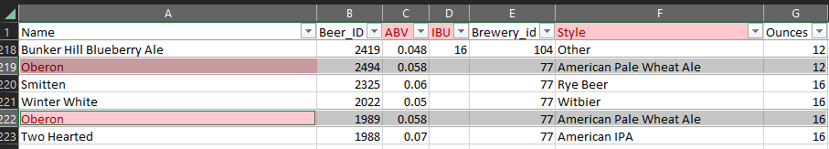
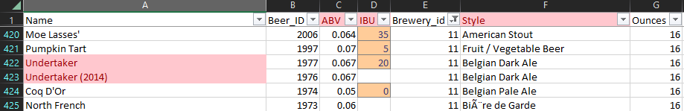
Duplicated beers
The dataset we received contained some beers that were the same except for the ounces. For most of our analysis we are not looking at the ounces, so we removed them from the dataset to make the data as clean as possible.
Same beers with different years in the names were also causing duplicates so we removed them as well.

Slide 10
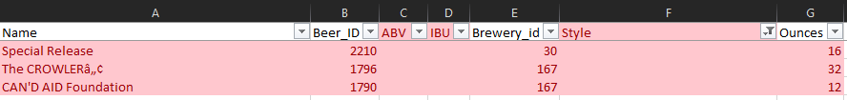
NA Style
Removed beers with missing Styles as no way to impute the data.

Slide 11
ABV & IBU

Slide 12
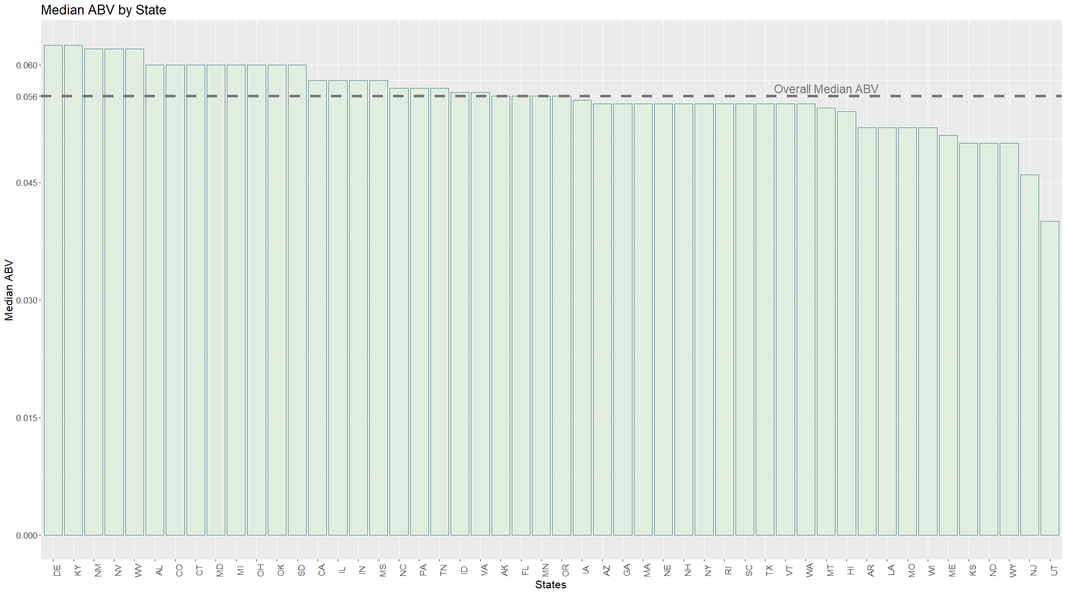
Median ABV
Kentucky and Delaware have the highest median alcohol content in beers
New Jersey and Utah have lowest median alcohol content in beers due to state regulations
The overall Median ABV is 5.6%

Slide 13
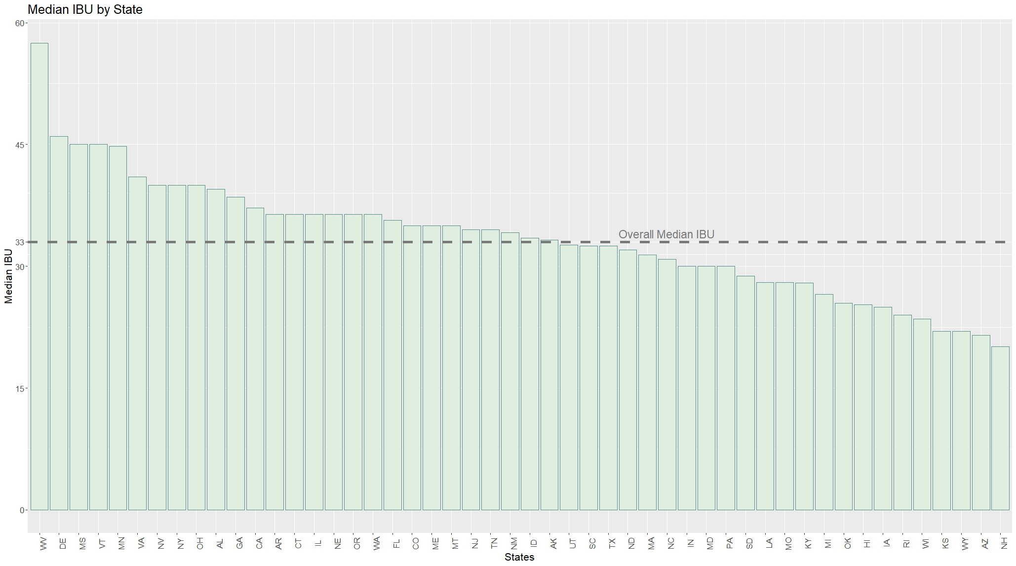
Median IBU
West Virginia has the highest median bitterness in beers
New Hampshire has lowest median bitterness in beers
The overall median IBU is 33

Slide 14
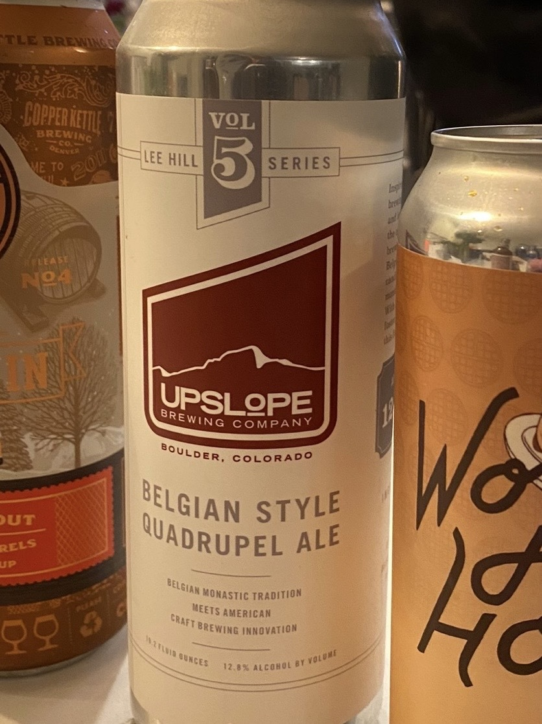
Maximum ABV
ABV(12.8%)
Lee Hill Series Vol. 5 - Belgian Style Quadrupel Ale by Upslope Brewing Company in Boulder, Colorado

Slide 15
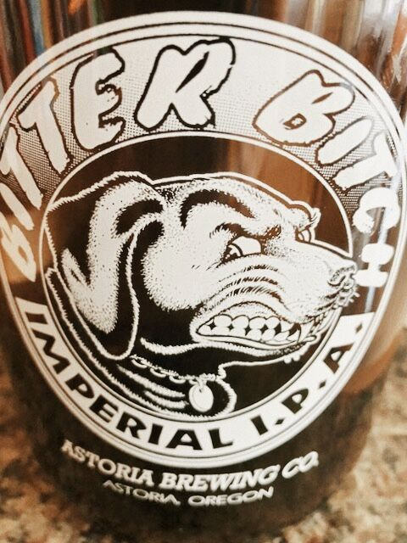
Maximum IBU
IBU(138)
Bitter Bitch Imperial IPA
by Astoria Brewing Company in Astoria, Oregon

Slide 16
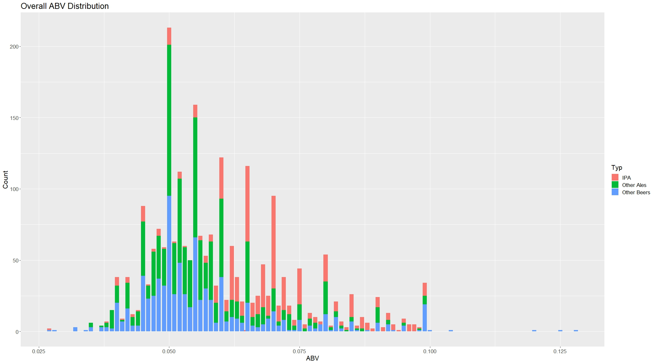
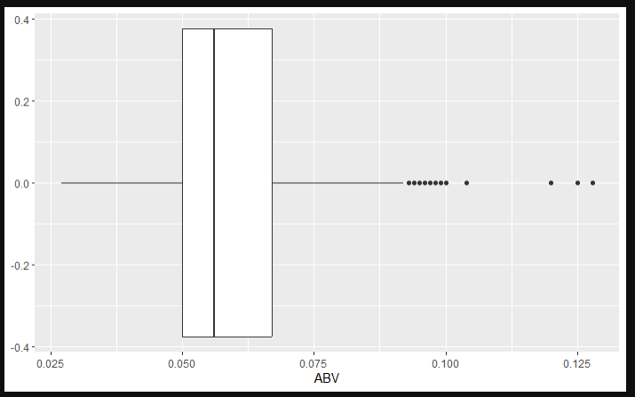
ABV summary
ABV data is right skewed
Min | Q1 | Median | Mean | Q3 | Max
2.7% | 5% | 5.6% | 5.97% | 6.7% | 12.8%

Slide 17
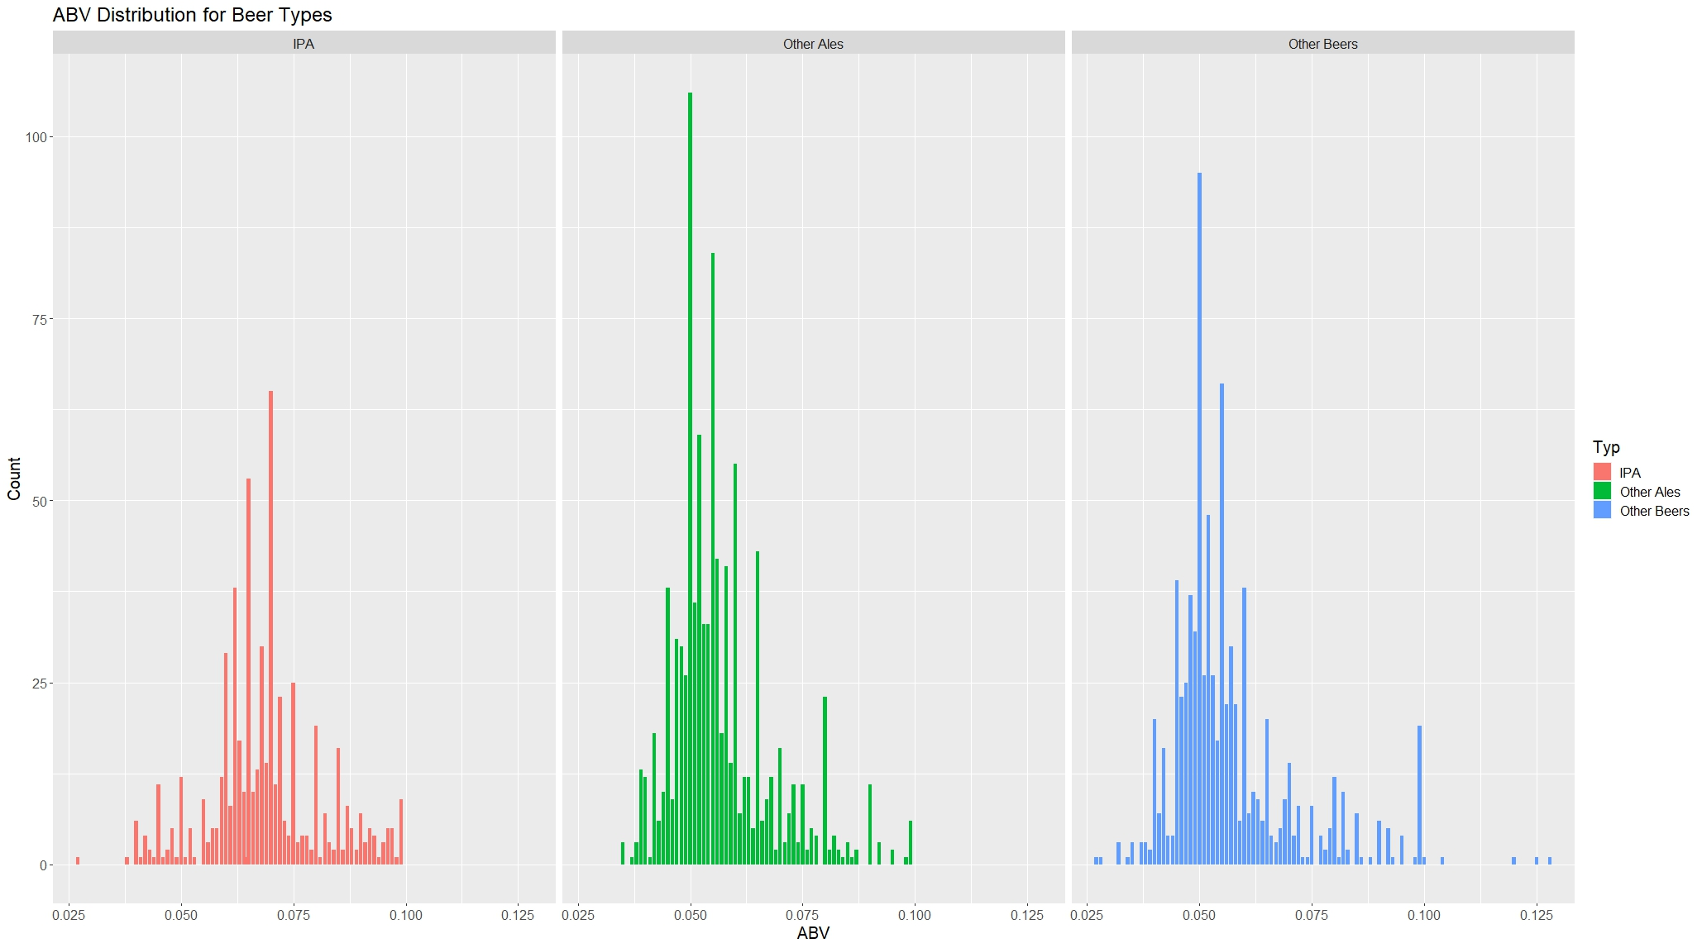
ABV summary

Slide 18
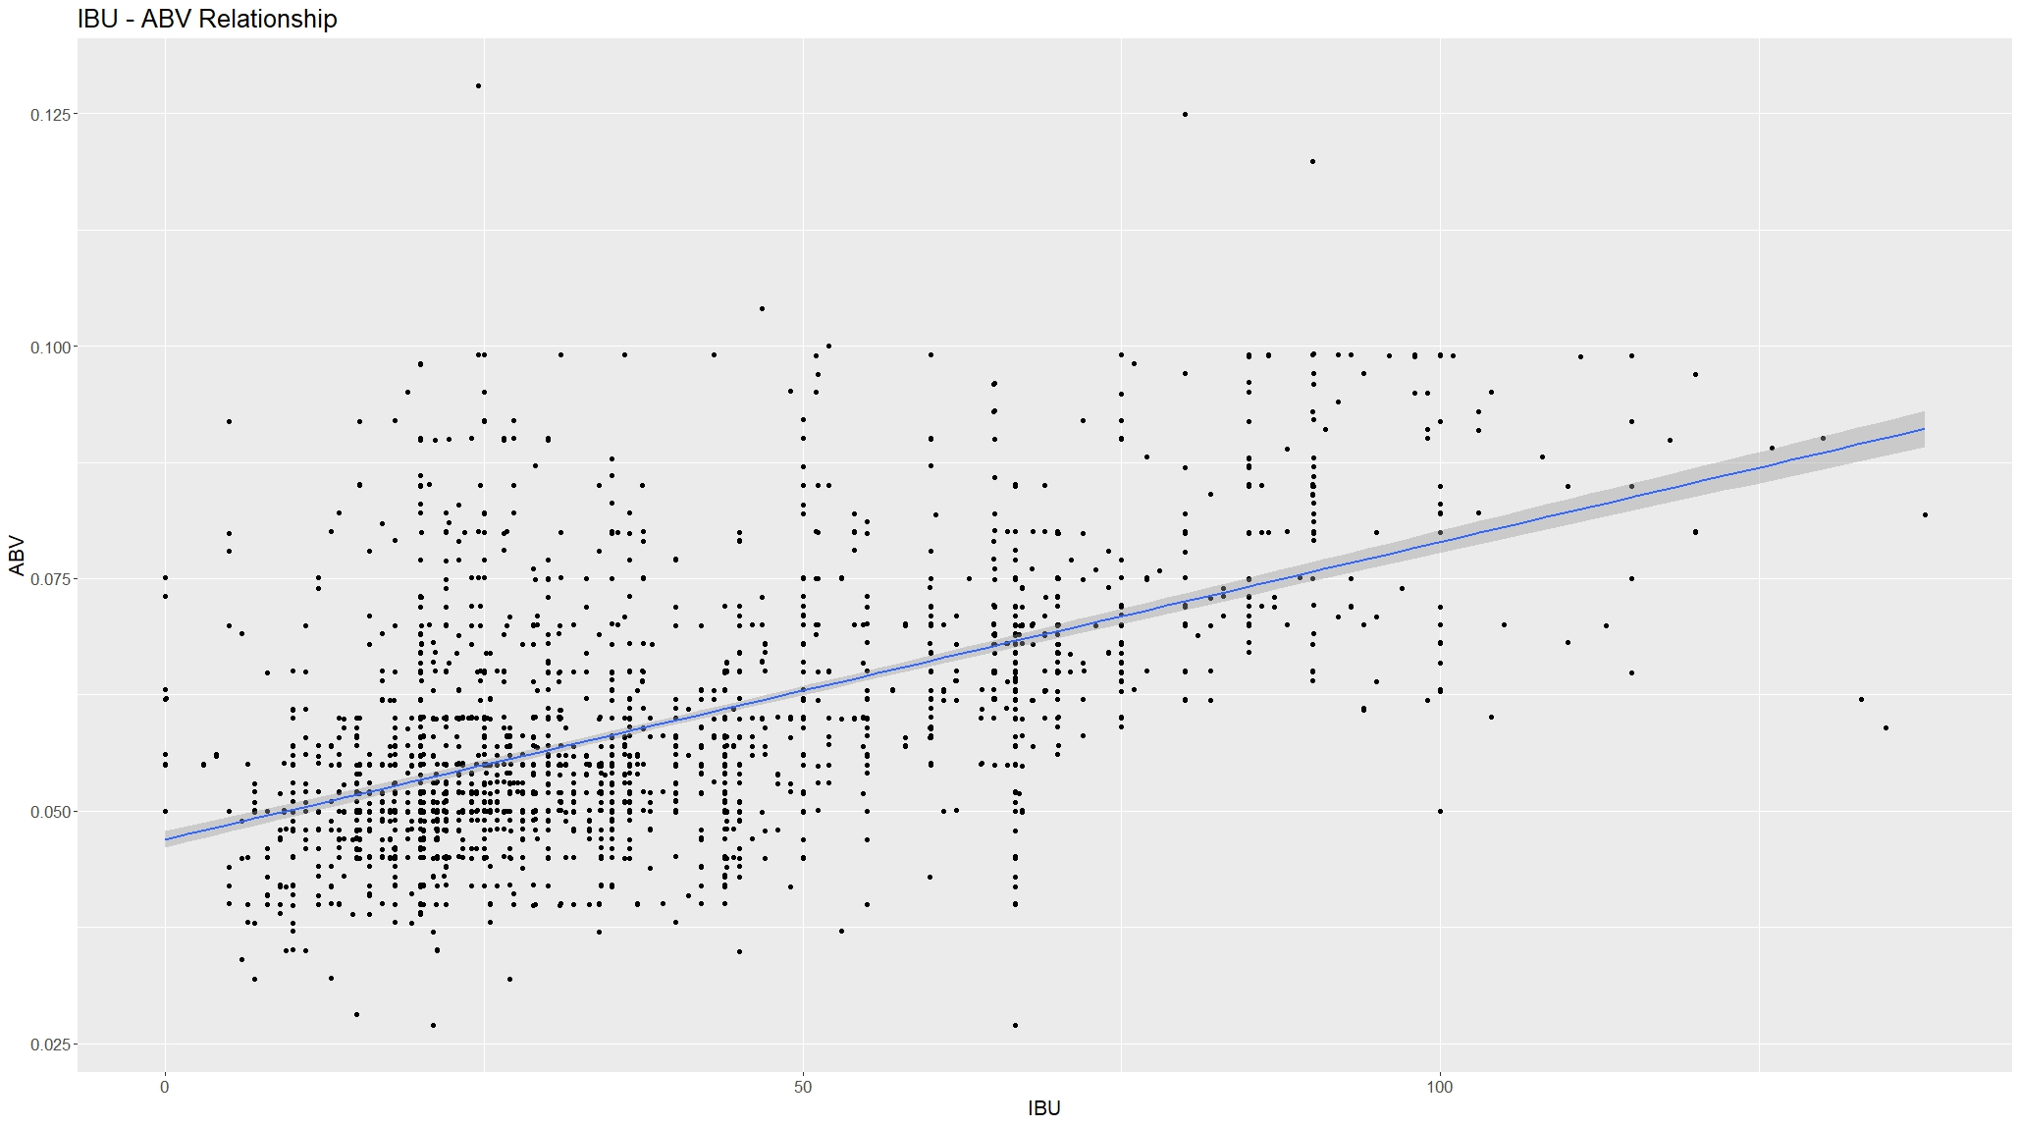
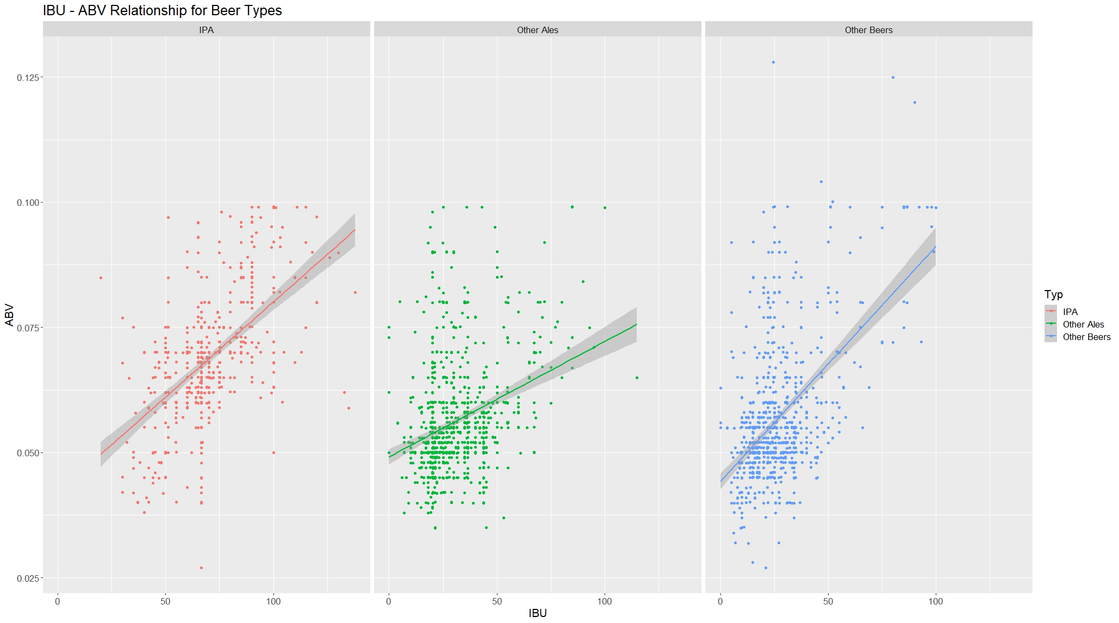
ABV-IBU RELATIONSHIP
The evidence suggest that there is a positive relationship between IBU and ABV.
Soft cap on ABV at 10%
The evidence suggests that IPAs are usually more bitter than other ales or other beer types.

Slide 19
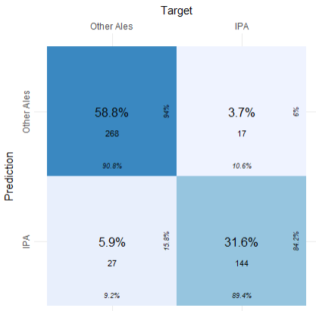
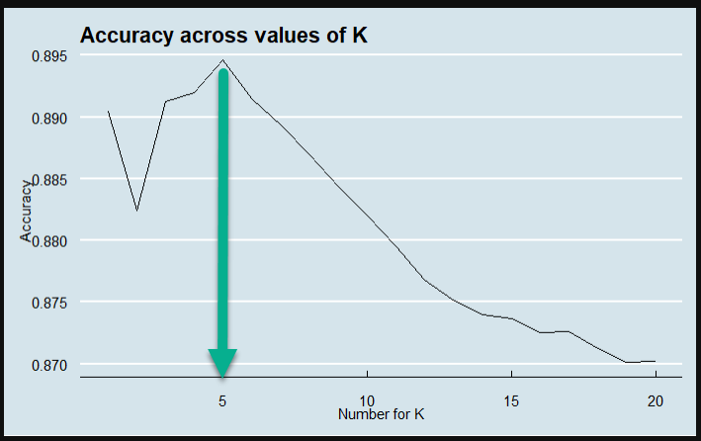
ABV-IBU RELATIONSHIP KNN Model
We iterated 200 times for values of K ranging from 1-20 and found that the optimal value for K is 5.
Looking at the results of our model it seems to be doing a great job classifying the IPAs vs. Other Ales with an accuracy of ~ 90%, sensitivity ~ 89.5% and specificity ~ 91%.

Slide 20
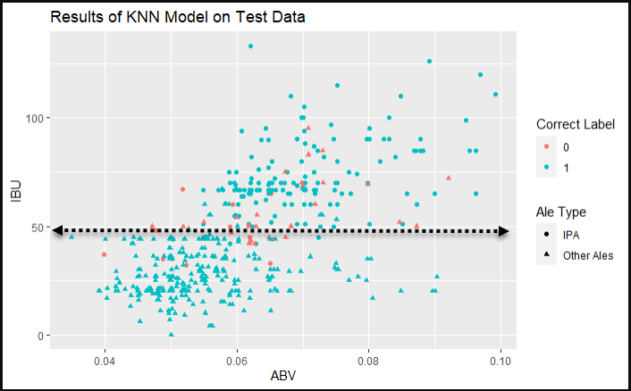
ABV-IBU RELATIONSHIP KNN Model
IPAs tend to be somewhere above 50 IBU’s and ales tend to fall below 50 IBU’s.
Looking at the results of the model on our training data it seems to be classifying the ale type even better than what we could eyeball as a good dividing line between IPA and Other Ales.

Slide 21
Recommendation

Slide 22
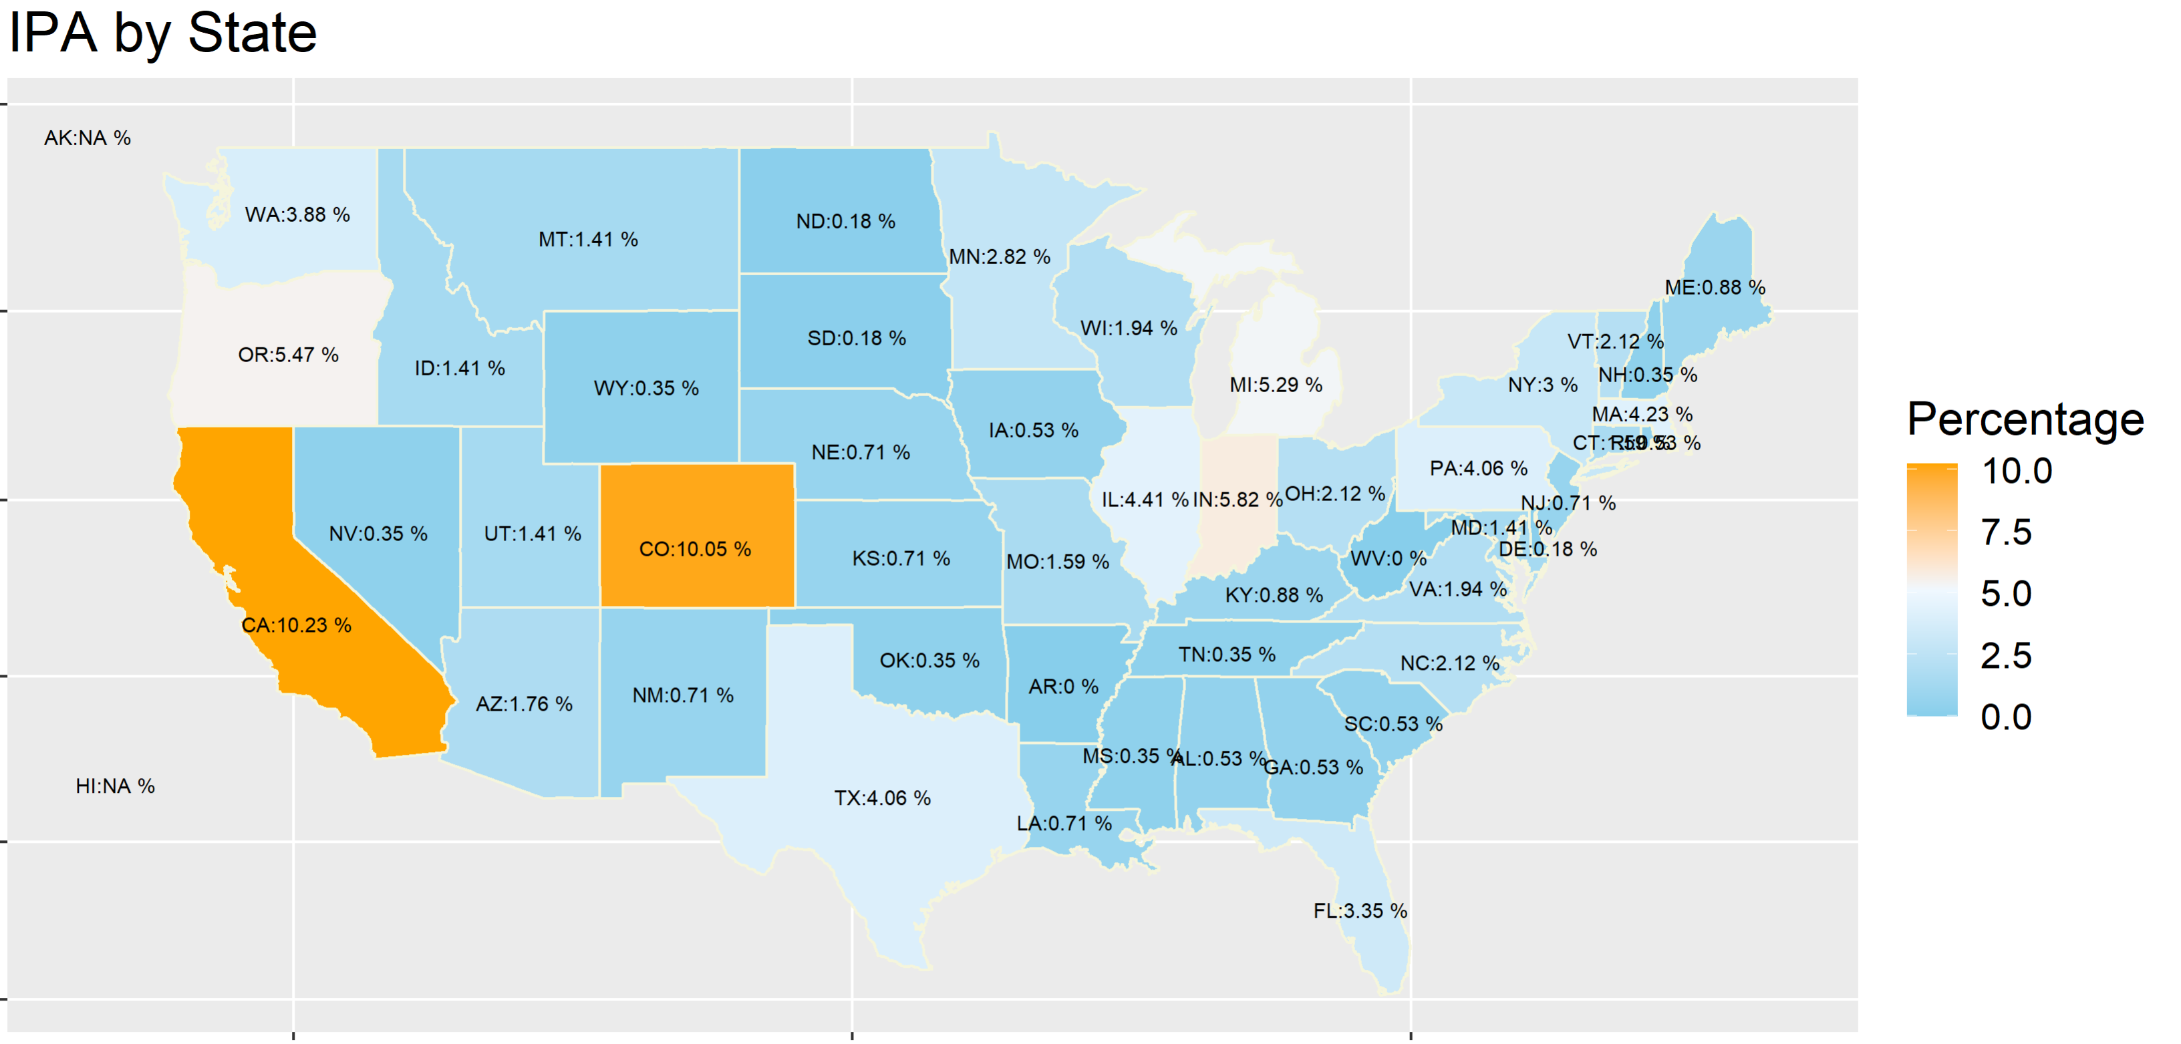
Recommendation for new beer
Low concentration of IPAs in southern part of the US
Florida has the 3rd largest population and Georgia has the 8th highest population in the US (https://www.statsamerica.org/sip/rank_list.aspx?rank_label=pop1)

Slide 23
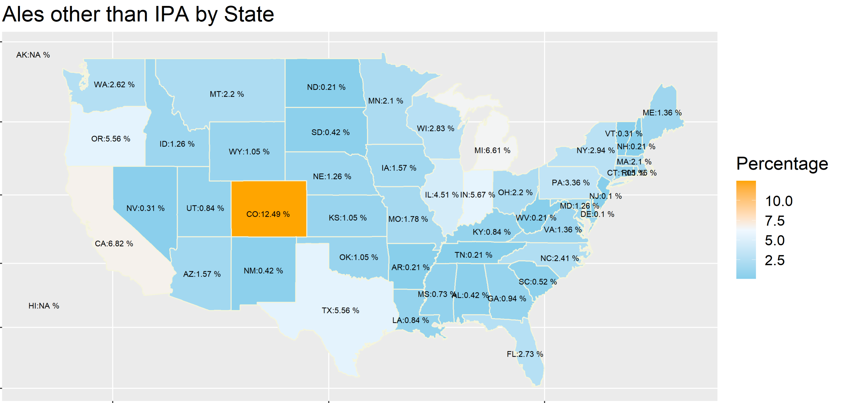
Recommendation for new beer
Similar situation for Ales with low concentration of ales in southern part of the US.
Our recommendation is to release a new beer IPA or Ale in the Florida/Georgia as there is the most opportunity in the state based on our analysis.

Slide 24
SUMMARY
Breweries seems to be clustered along the west cost, northeast and eastern Midwest US.
The evidence suggest as IBU goes up so does ABV.
The evidence suggest that a common defining factor between IPAs and Other Ales is IBU
To introduce new beers, Budweiser should look to release a new IPA or Ale in Florida and/or Georgia.

Slide 25
THANK YOU
Jake Rastberger – jrastberger@mail.smu.edu
Lijo Jacob – lijoj@mail.smu.edu
Lijo’s YouTube Video Link -https://youtu.be/HuEdO7g6R2Q

